Slide 1
Screwworm by Dr. Hussein AlNaji

Slide 2
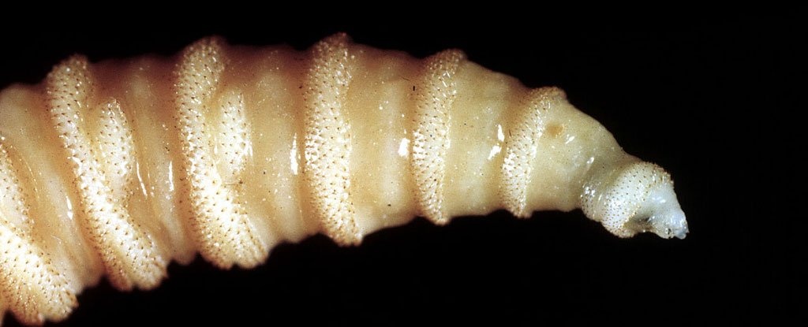
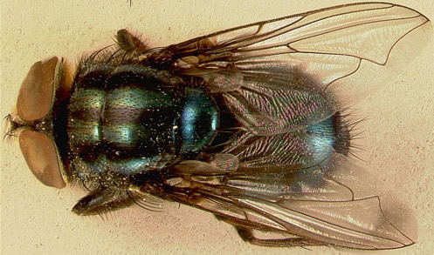

Slide 3
Screwworms are the larvae (maggots) of a certain fl y species that feed on living tissue of animals. Infestation of tissue by fly larvae is known as “myiasis
Etiology
Cochliomyia hominovorax in the New World (New World Screwworm) and Chrysomyia bezziana (Old World Screwworm) in Africa and Asia.
The screwworm is an insect that, in its adult stage, is about twice the size of the common housefly. It has orange eyes and a blue-gray or gray body with three dark stripes running down its back.

Slide 4
Hosts
All living warm-blooded animals can be infested by screwworm but they are most common in mammals while rare in birds
Many cases of screwworm myiasis have been documented in humans.
Humans are infected in the manner as animals. Any superficial wound is susceptible to infestation.
Humans are capable of transmitting screwworms over long distances when screwworm adults are carried in transport vehicles.

Slide 5
How can my animal get screwworm?
Screwworms (vector) are transmitted when a female fl y lays her eggs on a superficial wound of an animal. Screwworms can infest a wide variety of wounds (e.g. tick bites, dehorning or branding wounds, wire cuts, and other injuries). Navels of newborn mammals are a common site for screwworm infestation. Wounds infested by screwworms often attract other female screwworms and multiple infestations are common.

Slide 6
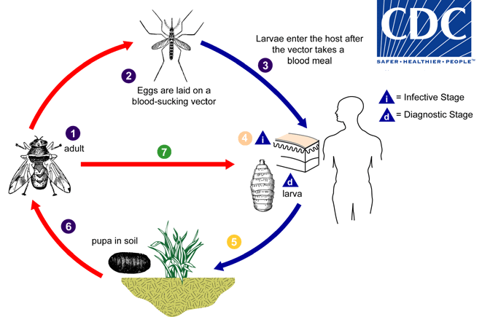

Slide 7
Clinical signs
The young larvae invade the nearby healthy tissues vigorously and do not feed on necrotic superfiCial tissue. A profuse brownish exudate, composed of larval excreta, and host fluids, pours from the wound and an objectionable odor is apparent.
Affected animals show irritation in the early phase of the infestation and by day 3 show pyrexia.
Animals do not feed but wander about restlessly, seeking shade and shelter.

Slide 8
Treatment
Insecticides have been compared.3 Lindane 3% and coumaphos 3% were the most effective but fenchlorphos 2.5%, diazinon 1.5%,chlorfenvinphos 0.05% and fenthionmethyl 0.2% were also very efficient. Stirofos (15%) and dichlorvos (20%) give season-long protection in the ears of cattle.
Ivermectin 200 mg/kg given sub- I cutaneously kills all Ch. bezziana larvae up to 2 days old and many older larvae.
Control
The eradication of screwworm by genetic means, chemical control, trapping techniques and lures, and dispersal of flies has been reviewed

Slide 9
THANK YOU

